Slide 1
Public Employee Retirement System - PERS
Kim West – WCSD Payroll
775-325-2078

Slide 2
Who is PERS eligible?
Employees that are regularly schedule to work 20 hours or more
Not a temporary employee
Not On-Call employee

Slide 3
Plan B and Plan A

Slide 4
Plan B
Employee/Employer Paid Plan
Plan B, Schedule B, Split plan
Employees will contribute 15.25% of gross monthly wages
WCSD will contribute 15.25% of employee’s monthly wages
Higher hourly rate of pay, but take home pay is lower
Option to refund the employee’s portion of the contributions

Slide 5
Plan A
WCSD will paid the full contribution
29.25% of the gross monthly wages
Lower hourly rate of pay, but take home pay is slightly higher

Slide 6
Differences between Plan “A” and “B”
If enrolled in Plan B employee can switch to Plan A at any time
Once you are sign up with Plan A, will have to remain in that plan. Even if the employee goes to work at another choice agency.

Slide 7
Vesting
5 years of service credit
Service credit is based on hours worked, not the actual time with WCSD
2 pay period month, based hours are 160
3 pay period month, based hours are 240

Slide 8
Example Contribution Plan Comparison
 | Employee/ Employer Plan B | Employer Plan A
1. Gross Salary | $2,500 | $2,500
2. Reduction for employer pay | n/a | 230
3. Adjusted gross salary | $2,500 | $2,270
4. Employee retirement contribution | 263 | n/a
5. 15% Income Tax Withholding | 375 | 341
6. Take-home pay | $1,862 | $1,929
Line 1 and 2 don’t apply to WCSD
Estimated difference in monthly take-home pay: $67

Slide 9
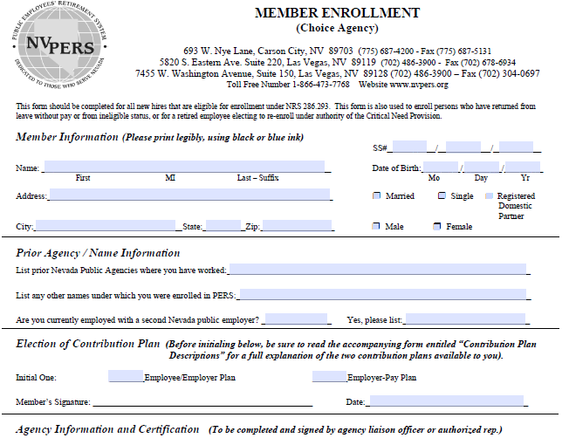
Name
Address
SS#
DOB
Marital status
Male or Female
Initial only one
Do not write below this line

Slide 10
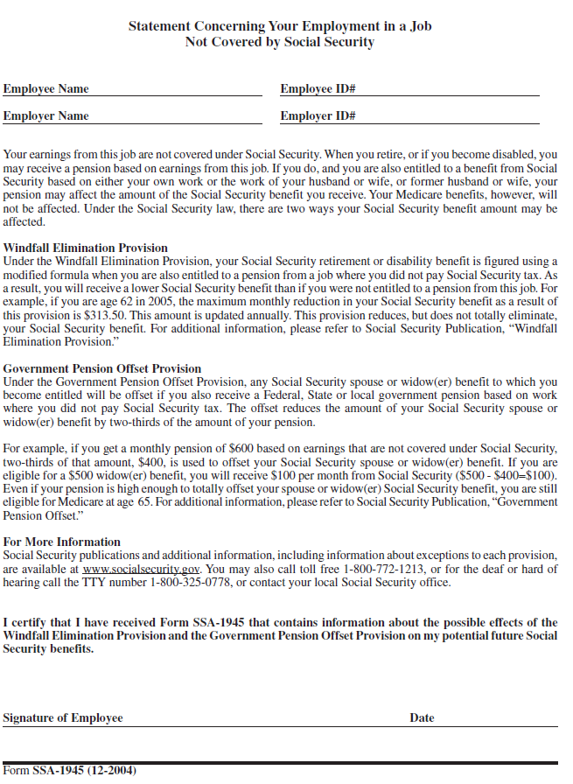
Employee ID is Full SSN

Slide 11
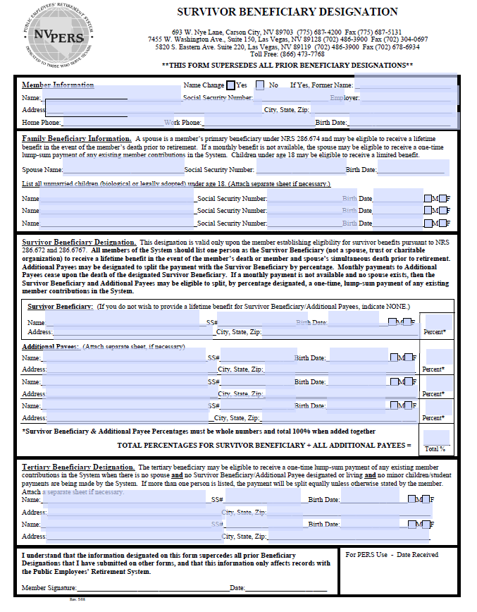

Slide 12
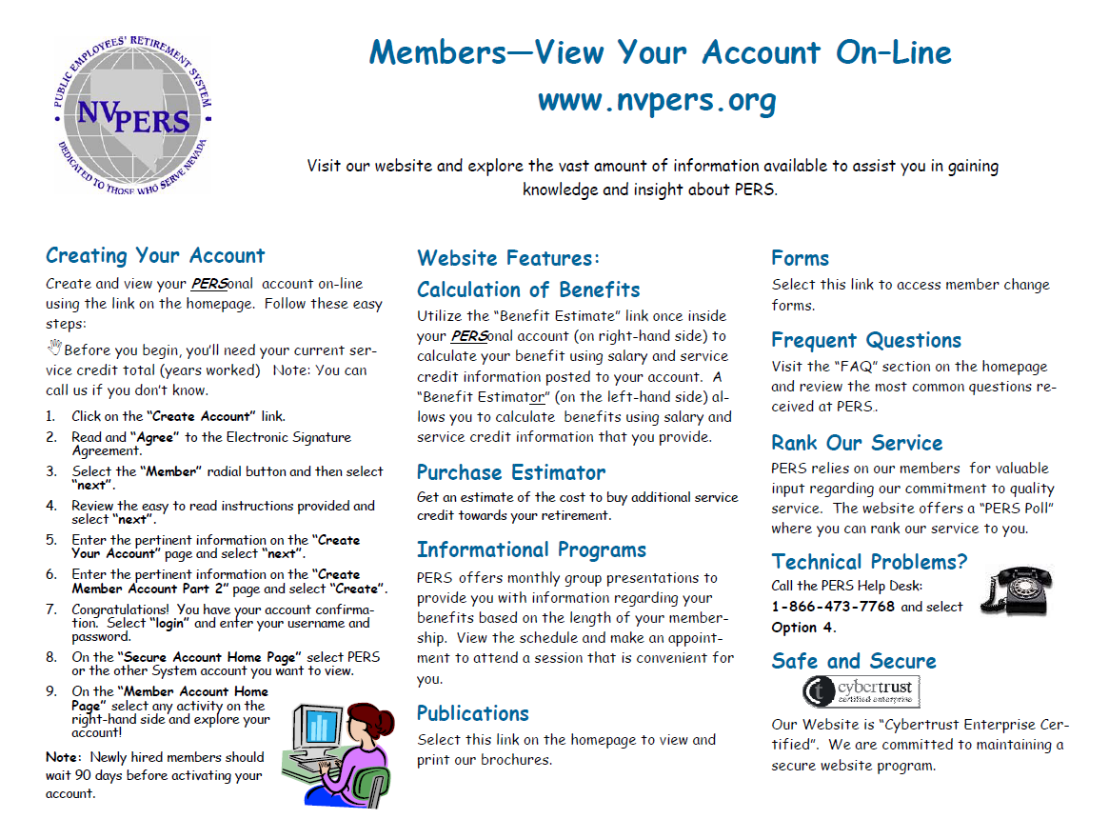

Slide 13
Questions

